Slide 1

IDS Project
Dataset : Kepler exoplanet search results
Ria Kalia
Anagha M
Section F

Slide 2
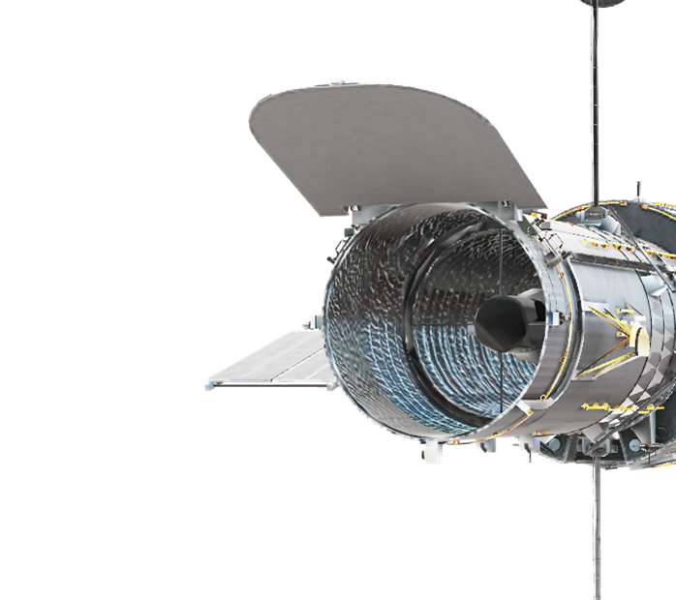
Kepler exoplanets
The Kepler Space Observatory is a NASA-built satellite that was launched in 2009. The telescope is dedicated to searching for planets (mainly earth size) in star systems besides our own, with the ultimate goal of possibly finding other habitable planets besides our own. (The original mission ended in 2013 due to mechanical failures, but the telescope has nevertheless been functional since 2014 on a "K2" extended mission.) The K2 mission ended on October 30th 2018. It discovered (confirmed) around 2300 planets in its lifetime.
This dataset has 9564 rows and 50 columns, out of which 5 are categorical. The important columns are,
kepoi_name : A KOI is a target identified by the Kepler Project that displays at least one transit-like sequence within Kepler time-series photometry. (This method detects distant planets by measuring the minute dimming of a star as an orbiting planet passes between it and the Earth. The passage of a planet between a star and the Earth is called a "transit." If such a dimming is detected at regular intervals and lasts a fixed length of time, then it is very probable that a planet is orbiting the star and passing in front of it once every orbital period.The dimming of a star during transit directly reflects the size ratio between the star and the planet☺
koi_disposition ; The theoretical disposition towards this exoplanet candidate. One of CANDIDATE, FALSE POSITIVE or CONFIRMED.
koi_pdisposition : The disposition Kepler data analysis has towards this exoplanet candidate. One of FALSE POSITIVE or CANDIDATE.
koi_score :A value between 0 and 1 that indicates the confidence in the KOI disposition

Slide 3
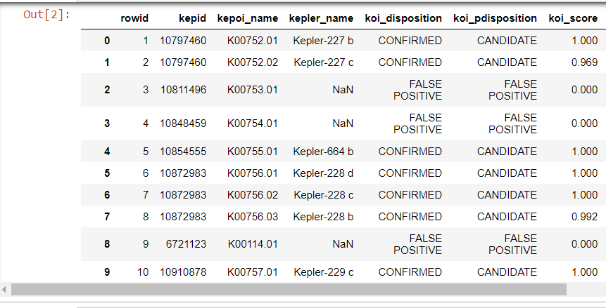

Slide 4
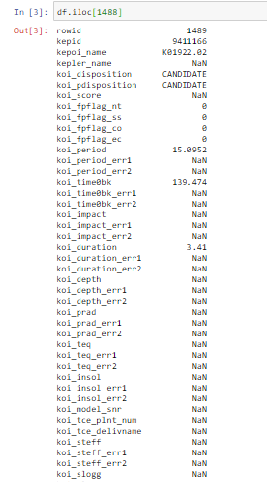
DATA CLEANING
Values of a particular row before cleaning –
(this is for a particular kepler exoplanet that goes by the name K01922.02)

Slide 5
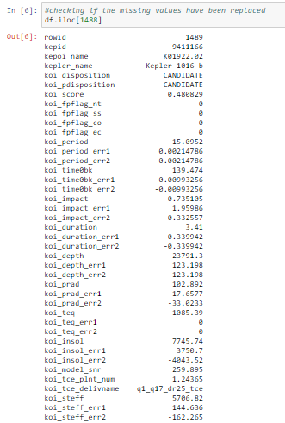
DATA CLEANING
Values of the same row after cleaning the numerical and categorical columns

Slide 6
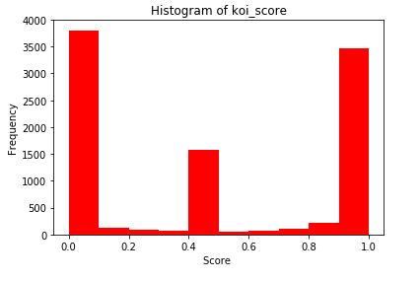
DATA VISUALIZATION
Histogram of koi_score
Most of the scores have extreme values: between 0-0.1 and 0.9-1
A few values lie in the middle - between 0.4 and 0.5
Very few values lie in the 0.1-0.4 and 0.5-0.9 range
Since this is the confidence in the theoretical disposition towards being an exoplanet, most of the scores are completely confident (1), not confident (0) and average (0.5)

Slide 7
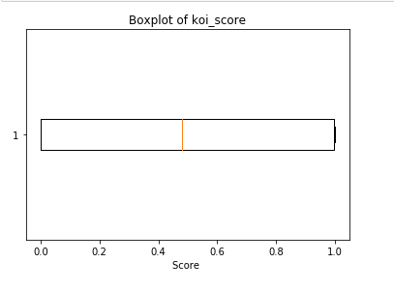
DATA VISUALIZATION
Boxplot of koi_score
No outliers present
No whiskers present, hence there are no values before 0 and after 1 (koi_score is only supposed to be between 0 and 1
Hence all values are within range

Slide 8
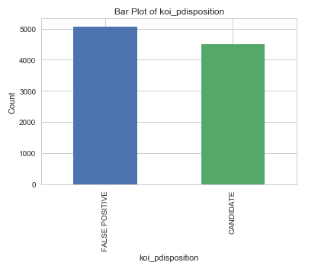
DATA VISUALIZATION
Distribution of koi_pdisposition
False positive could mean:
Another star passing in front of the star, for instance, or instrumental effects from Kepler itself, adding up in just the right way.
A candidate is an object which isn’t determined yet to be a planet or the afore mentioned objects.

Slide 9
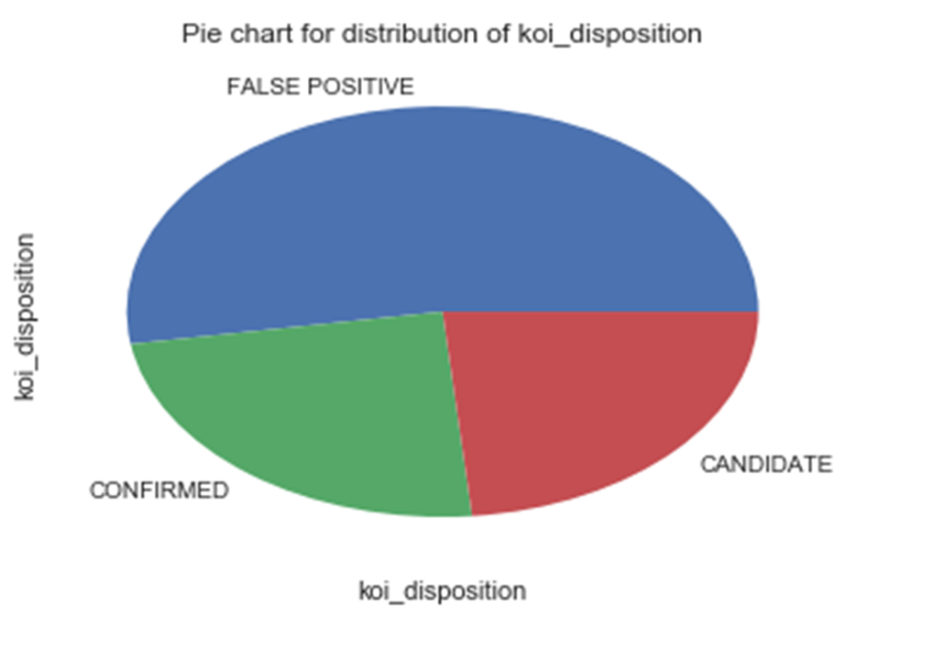
Distribution of koi_disposition
Inference:
When calculated, there are more false positive due to other objects in space like other stars, etc passing in front of the concerned star causing a transition like sequence.

Slide 10
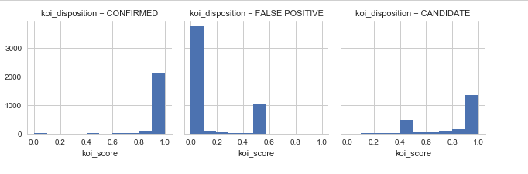
DATA VISUALIZATION
Distribution of koi_score based on koi_disposition using histograms
Inference: CONFIRMED - koi score is closer to 1 because its confidence of being a planet is very high. FALSE POSITIVE - Not a planet, so its closer to 0 . CANDIDATE - could be false positive or confirmed.

Slide 11
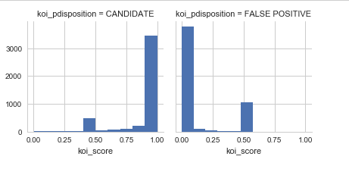
DATA VISUALIZATION
Distribution of koi_score based on koi_pdisposition using histograms

Slide 12
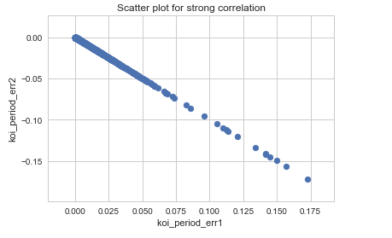
Correlation
Example for strong correlation – between koi_period_err1 and koi_period_err2
Scatter plot for it -

Slide 13
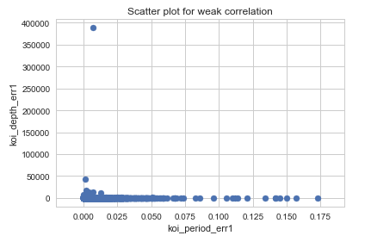
Correlation
Example for weak correlation – between koi_period_err1 and koi_depth_err1
Scatter plot for it -

Slide 14
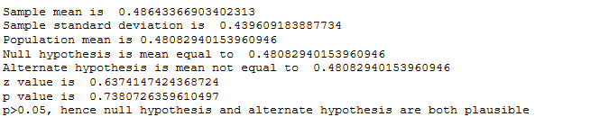
Hypothesis Testing
Null hypothesis : Mean = 0.48
Alternate hypothesis : Mean != 0.48

Slide 15
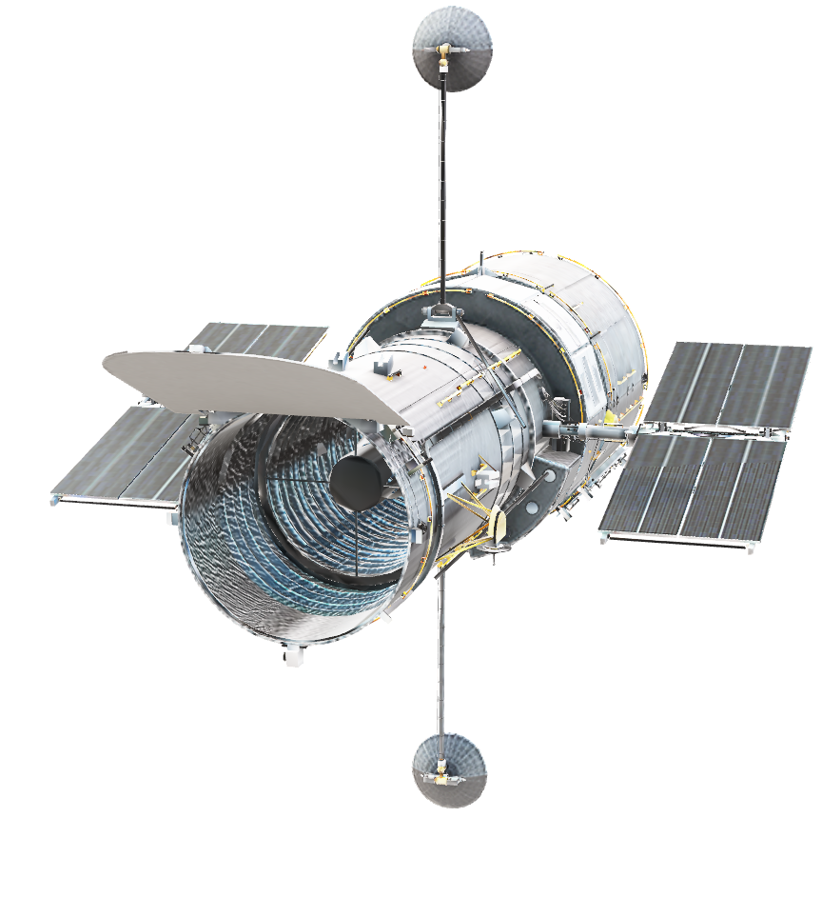
Thank you!

